Slide 1

Getting started with Q Imaging cameras and SITK® for LabView

Slide 2
Opening the camera
Go to the SIToolkit/LabVIEW/ExamplesXX folder.
Go to the Open-Close folder
Select ExOpenGlobalCam.vi and run it.
The green light should come on when the camera is opened succesfully.
Keep camera open until you are ready to leave Labview then run ExCloseGlobalCam.vi which will close the camera and do clean up.

Slide 3
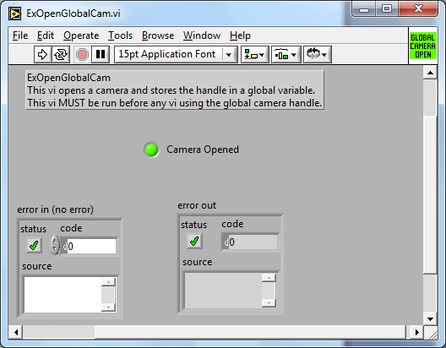

Slide 4
Collecting data
Go to the Q-Imaging Folder in Examples.
This contains many examples.
Select ExQCircBufROI.vi and fill in exposure and x and y dimension.
Run the example and you should see a display that is collecting data.
Hit the “STOP” button on the front panel (not the LabVIEW vi stop)

Slide 5
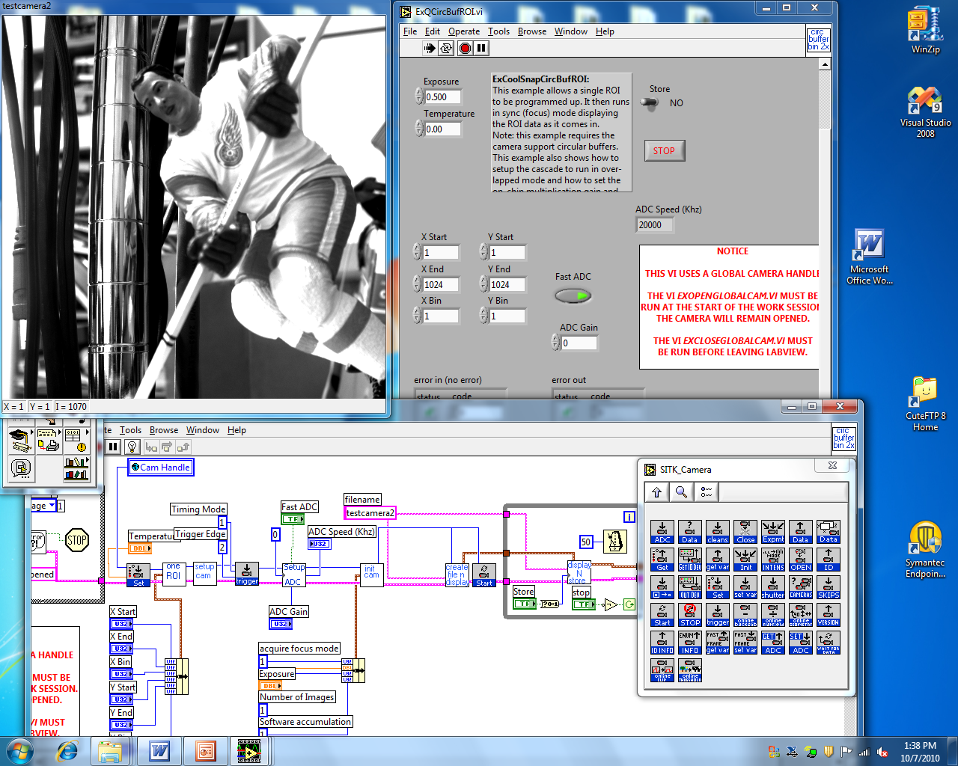

Slide 6
Other programs that can be run.
After the STOP button has been hit you can rerun this program or try other programs.
ExQCircBufROI.vi shows focus mode which continuously captures data.
ExSimpleAsyncExampleGblQ.vi shows how to capture single frames at a time.
ExQSnapNframeSeq.vi shows how to capture a sequence of frames fast (stored in ram, then displayed when done).

Slide 7
Color cameras
If you have a color camera, you can still use previous programs but the images will be grayscale. An example of getting a color image is the data collection example ExQCircBufColor.vi.
Fill in red, green and blue gains. These may be different for each color camera. Some good defaults are loaded.

Slide 8
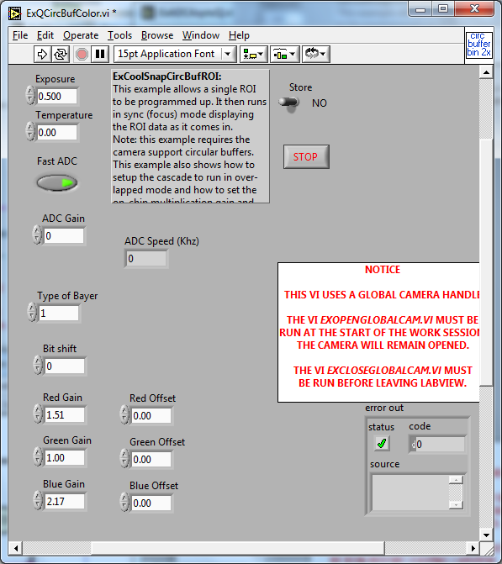

Slide 9
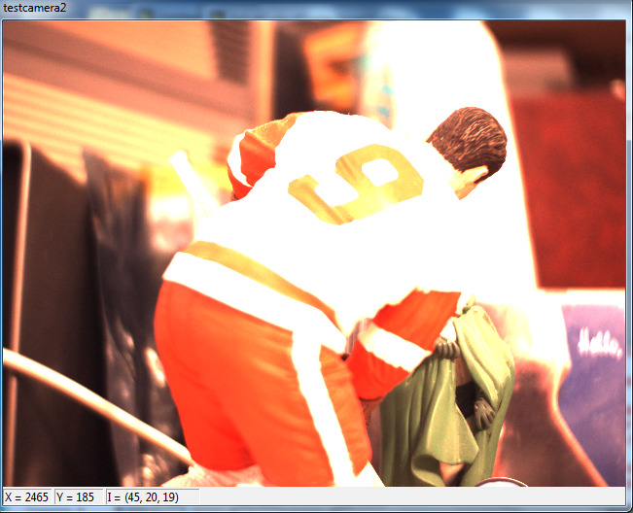

Slide 10
SITK® for LabView Pallets
There are 7 pallets in the user library that are supplied
Advanced Display: Full image support including overlays
Camera: Camera setup and data collection
Simple Display: Fast but limited feature image display.
File: including Tif and Spe file formats.
Image: allows pixels, rows, columns and full images to be retrieved and placed in the SITK® internal data structures.
Math: general math operations, including statistics, that are quicker than bringing data out to LabView
General: miscellaneous functions

Slide 11
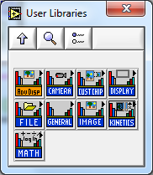

Slide 12
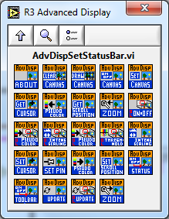

Slide 13
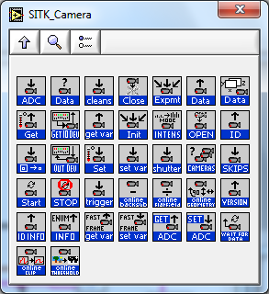

Slide 14
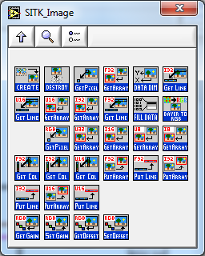

Slide 15
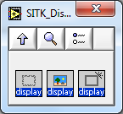
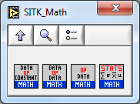
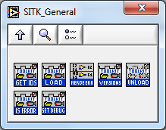
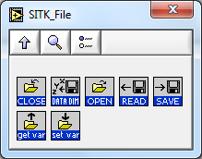

Slide 16
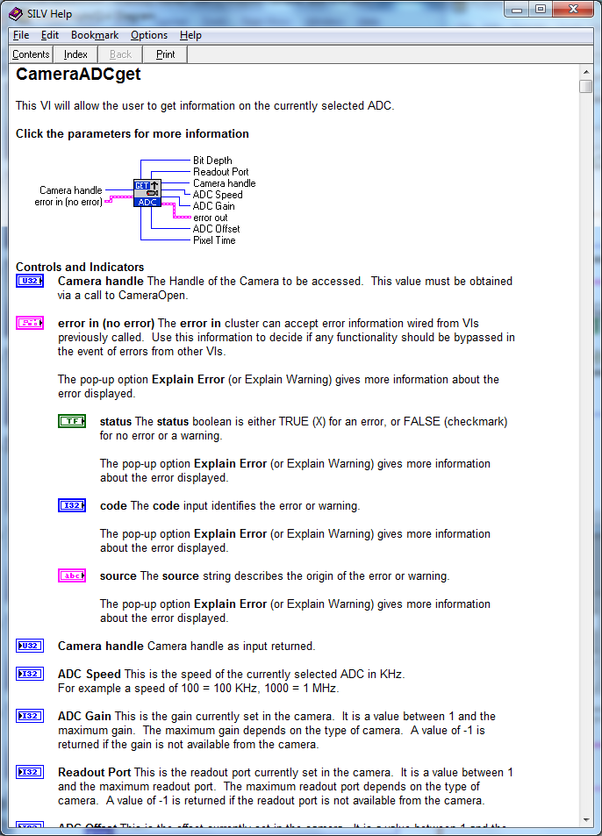
Online help
Right click on an SITK® Vi and select Help

Slide 17
Close camera
Before leaving LabView you should close the camera so that the software buffers are cleaned up and the camera dll’s are unloaded.
To do this go back to the Open-Close folder and run ExCloseGlobalCam.vi

Slide 18
